Slide 1
PHYSICS IN TRANSPORTATION part 2

Slide 2
Review
Fluid static – fluid at rest
Density - amount of mass per unit volume
Specific gravity
Buoyant Force
Archimedes’ Principle
Pressure – force per unit area
Pascal’s Principle

Slide 3
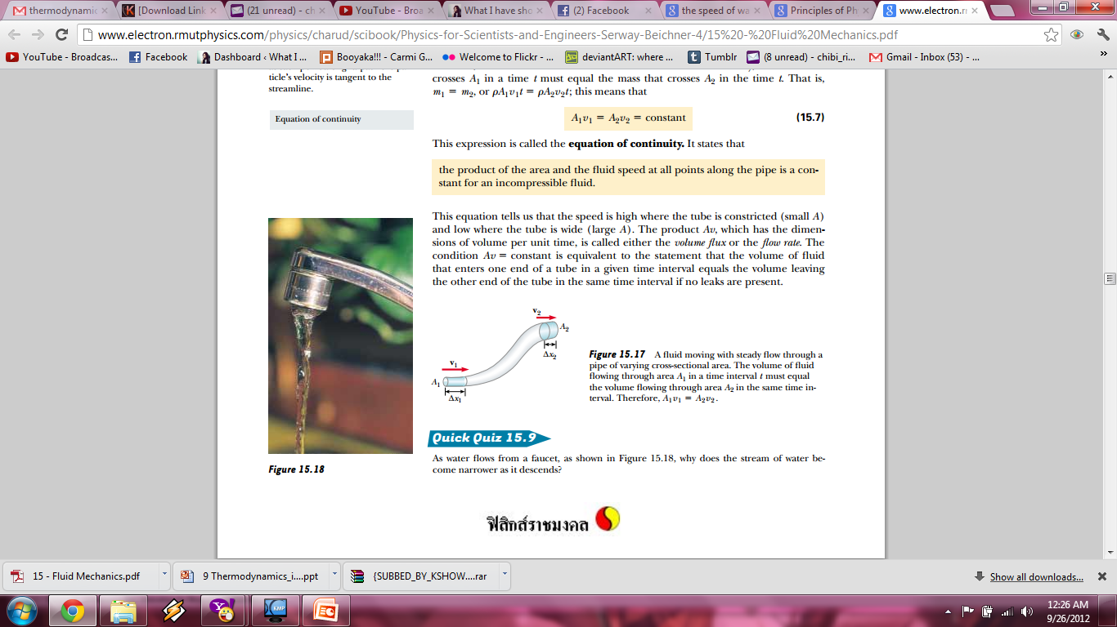
Fluid Dynamics
study of fluids in motion.

Slide 4
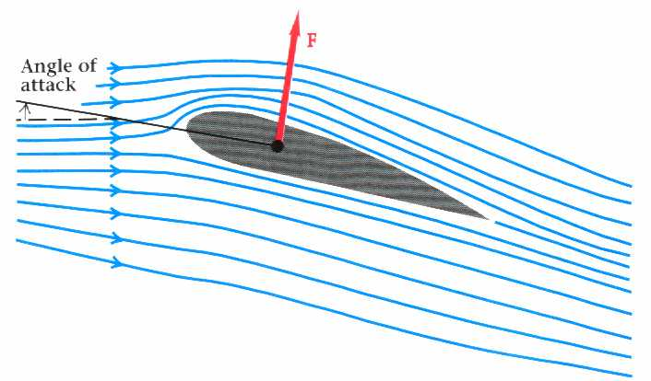
Streamline
path followed by the fluid
reflects the velocity of the fluid
Arrow → direction
Density of lines → magnitude (speed)
High speed
Low speed

Slide 5
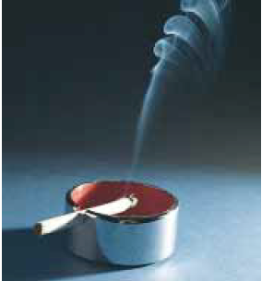
2 kinds of flow
Laminar Flow - orderly flow of neighboring layers of fluid. Streamlines do not cross over each other.
2. Turbulent Flow - irregular, complex flow of fluids.

Slide 6
Speed of Fluid Fluid
Factors affecting speed of fluid flow:
Area (Continuity Equation)
Pressure (Bernoulli’s Equation)

Slide 7
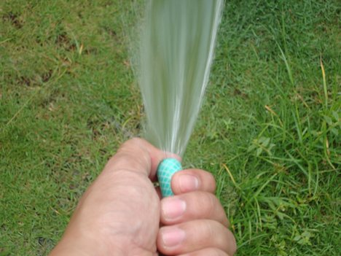
Continuity Equation
Derive from conservation of mass
A = area
V = speed

Slide 8
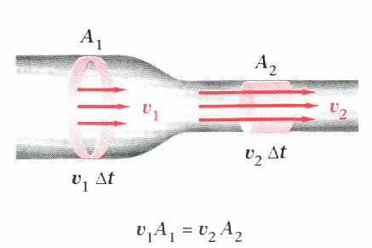
Area and Velocity
large area
low speed
Small area
High speed

Slide 9
Bernoulli’s Equation
Derive from conservation of energy
From
potential energy
From Work
(Pressure)
From Kinetic energy

Slide 10
Pressure and Velocity
If elevation (h) is the same, then

Slide 11
Direction of Fluid Flow
high pressure
low pressure

Slide 12
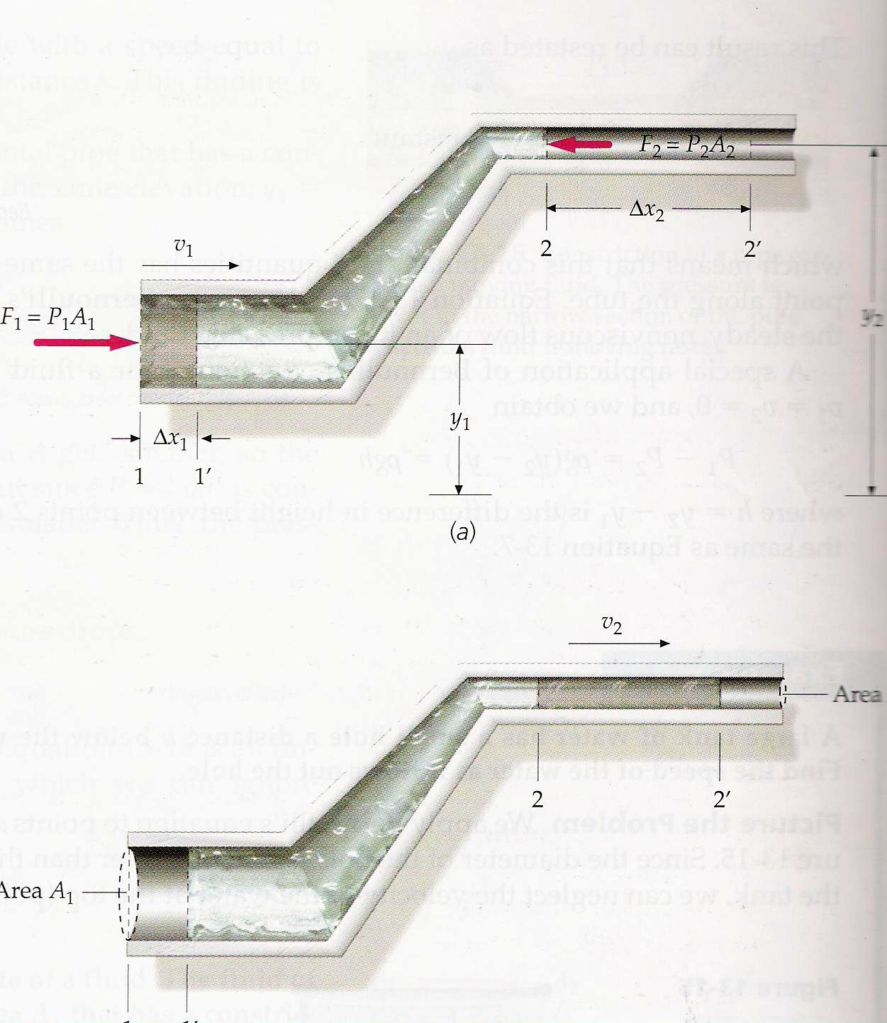
Pipeline
How can fluids move up the pipe?
2
1

Slide 13
Pressure Requirement
high pressure → low pressure
Low Pressure ??
1
2
High Pressure ??

Slide 14
V ? : Continuity Equation
2
1

Slide 15
Pressure?
2
1

Slide 16

P? Bernoulli’s Equation
2
1
If (ρv²/2) and (ρgh) are down, P must goes up to maintain a constant sum

Slide 17
Fluid can move up!
high pressure → low pressure
2
1

Slide 18
“Kissing Balls” Experiment

Slide 19
Two Balls
If you blow air between the two balls, what will happen?
Move closer
Move apart
wind

Slide 20
Using Bernoulli’s Principle

Slide 21
Ans: move closer
Higher pressure → Lower pressure

Slide 22
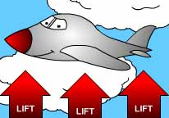
How do airplanes lift?

Slide 23
Assume the height difference is small
Lift
(more dense lines)
(less dense lines)
Higher pressure → Lower pressure

Slide 24
Funnel Experiment

Slide 25
Funnel Experiment
What direction will the ball goes?
wind
a) Right →
b) Left ←

Slide 26
Continuity Equation
2
1

Slide 27
Bernoulli’s Principle
2
1

Slide 28
What direction?
Higher pressure → Lower pressure
2
1
The ball will move to the left

Slide 29
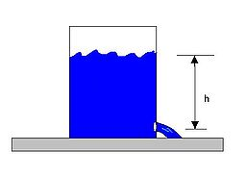
Torricelli’s Theorem
relates the speed of fluid flowing out of an opening to the height of fluid above the opening.

Slide 30
Torricelli’s Theorem
Derive from continuity equation and Bernoulli’s equation
Opening 1
A₁ (very large), v₁ ≅ 0
Opening 2

Slide 31
Torricelli’s Theorem
Atm pressure
v₁ ≅ 0
Atm pressure

Slide 32
Torricelli’s Theorem
Atm pressure
v₁ ≅ 0
Atm pressure

Slide 33
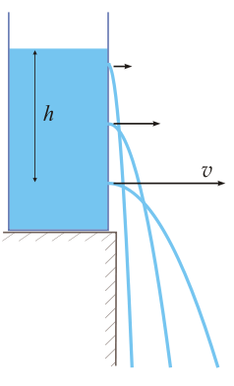
Torricelli’s Theorem

